Slide 1
Circuit Theorems
Circuit Theorems
1

Slide 2
Circuit Theorems
↔ Introduction
↔ Linearity property
↔ Superposition
↔ Source transformations
↔ Thevenin’s theorem
↔ Norton’s theorem
↔ Maximum power transfer

Slide 3






1 Introduction
A large complex circuits
Simplify circuit analysis
Circuit Theorems
‧Thevenin’s theorem
‧Circuit linearity
‧source transformation
Norton theorem
Superposition
max. power transfer

Slide 4


2 Linearity Property
Homogeneity property (Scaling)
i → v = iR ki → kv = kiR
Additivity property
i₁ → v₁ = i₁R i₂ → v₂ = i₂ R
i₁ + i₂ → (i₁ + i₂ )R = i₁R + i₂ R = v₁ + v₂

Slide 5
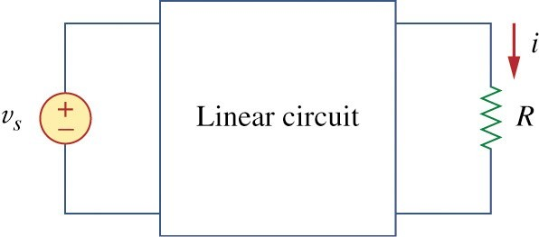
↔ A linear circuit is one whose output is linearly related (or directly proportional) to its input
↔ Fig. 1
i
V₀
I₀

Slide 6
↔ Linear circuit consist of
linear elements
linear dependent sources
independent sources
v = 10V → i = 2A
s
v = 1V → i = 0.2A
s
v_{s} = 5mV← i =1mA
↔
_{v}2
2
p = i R =
: nonlinear
R

Slide 7
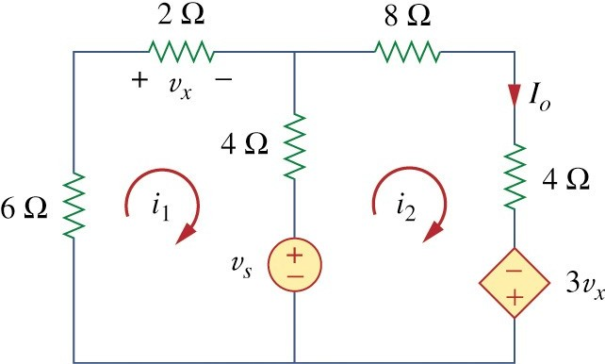
Example 1
↔ For the circuit in fig 2 find I₀ when v_{s}=12V and v_{s}=24V.

Slide 8
Example 1
↔ KVL
12i₁ − 4i₂ + v_{s} = 0
− 4i₁ + 16i₂ − 3v_{x} − v_{s} = 0
v_{x} = 2i₁
(4.1.2) becomes
−10i₁ + 16i₂ − v_{s} = 0
Eqs(1.1) and (1.3) we get
2i₁ + 12i₂ = 0 → i₁ = −6i₂
(1.1)
(1.2)
(1.3)

Slide 9
Example 1
Eq(1.1), we get
− 76i₂ = v_{s} = 0 ⇒ i =
_{When} v_{s} = 12V
v
s
2
76
12
I₀ = i₂ = ₇₆ A
v_{s} = 24V
When
I = i = ²⁴ A
0 2
76
Showing that when the source value is doubled, I₀ doubles.

Slide 10
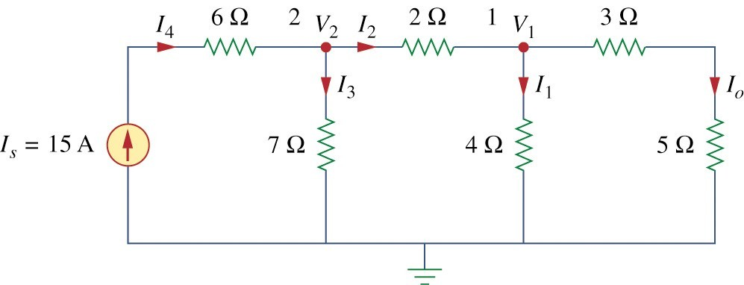
Example 2
↔ Assume I₀ = 1 A and use linearity to find the actual value of I₀ in the circuit in fig 4.

Slide 11
Example 2
If I₀ = 1A, then v₁ = (3 + 5)I₀ = 8V
I₁ = v₁ / 4 = 2A,
I₂ = I₁ + I₀ = 3A
V
V₂ = V₁ + 2I₂ = 8 + 6 = 14V, I₃ =
2
= 2A
7
I₄ = I₃ + I₂ = 5A ⇒ I_{S} = 5A
I₀ = 1A → I_{S} = 5A
I₀ = 3A ← I_{S} = 15A

Slide 12

3 Superposition
↔ The superposition principle states that the voltage across (or current through) an element in a linear circuit is the algebraic sum of the voltages across (or currents through) that element due to each independent source acting alone.
↔ Turn off, killed, inactive source:
independent voltage source: 0 V (short circuit)
independent current source: 0 A (open circuit)
↔ Dependent sources are left intact.

Slide 13

Steps to apply superposition principle:
↔
Turn off all independent sources except one source. Find the output (voltage or current) due to that active source using nodal or mesh analysis.
Repeat step 1 for each of the other independent sources.
Find the total contribution by adding algebraically all the contributions due to the independent sources.

Slide 14
How to turn off independent sources
↔ Turn off voltages sources = short voltage sources; make it equal to zero voltage
↔ Turn off current sources = open current sources; make it equal to zero current

Slide 15
↔ Superposition involves more work but simpler circuits.
↔ Superposition is not applicable to the effect on power.

Slide 16
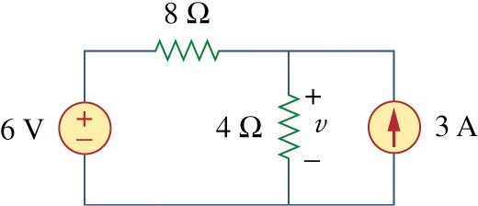
Example 3
↔ Use the superposition theorem to find circuit in Fig.4.6.
in the

Slide 17
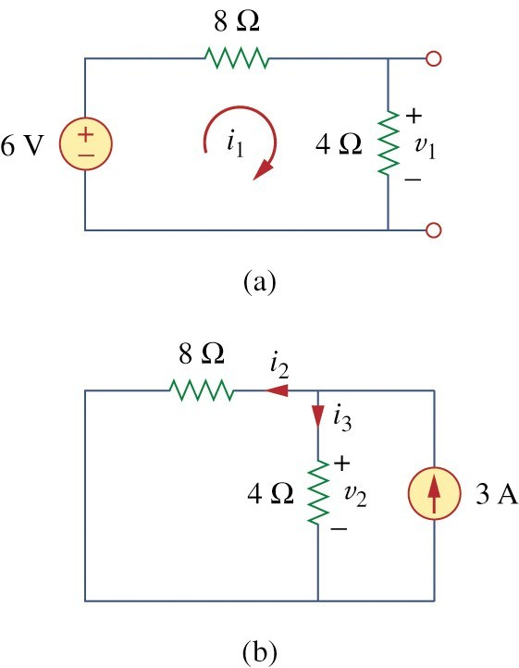
Example 3
Since there are two sources,
let
V = V₁ + V₂
Voltage division to get
4
V =
(6) = 2V
1
4 + 8
Current division, to get
8
i =
(3) = 2A
3
4 + 8
^{Hence} v = 4i = 8V
2 3
v = v₁ + v₂ = 2 + 8 = 10V
And we find

Slide 18
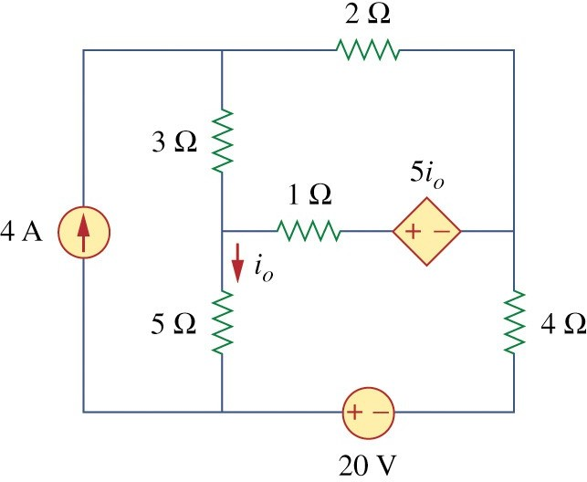
Example 4
↔ Find I₀ in the circuit in Fig.4.9 using superposition.

Slide 19
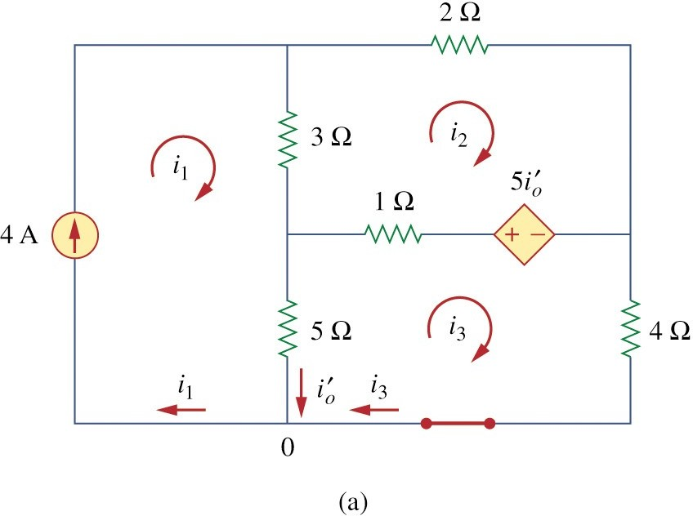
Example 4
Fig. 4.10

Slide 20
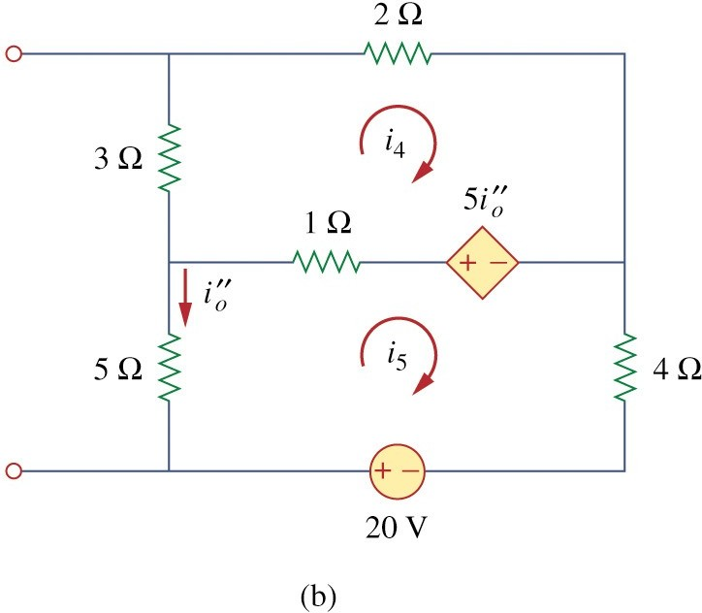
Example 4
Fig. 4.10

Slide 21

5 Source Transformation
↔ A source transformation is the process of replacing a voltage source v_{s} in series with a resistor R by a
current source i_{s} in parallel with a resistor R, or vice versa

Slide 22
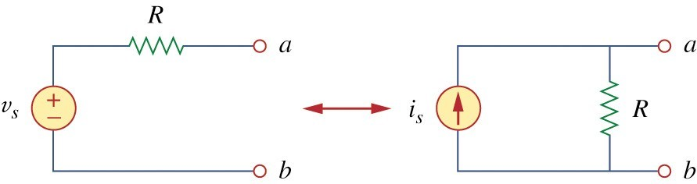
Fig. 15 & 16
v
v_{s} = i_{s} R or i =
s
s
R

Slide 23
Equivalent Circuits
i
i
+
v
+
v
v = iR + v_{s}
i = ^{v} − ^{vs}
R R
-
-
i
v
v_{s}
-i_{s}

Slide 24
↔ Arrow of the current source
positive terminal of voltage source
↔ Impossible source Transformation
ideal voltage source (R = 0)
ideal current source (R=∞ )

Slide 25
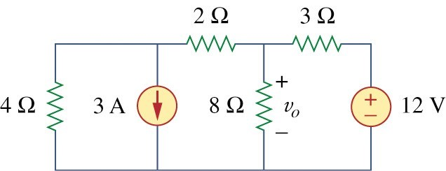
Example 6
↔ Use source transformation to find v_{o} in the circuit in Fig 17.

Slide 26
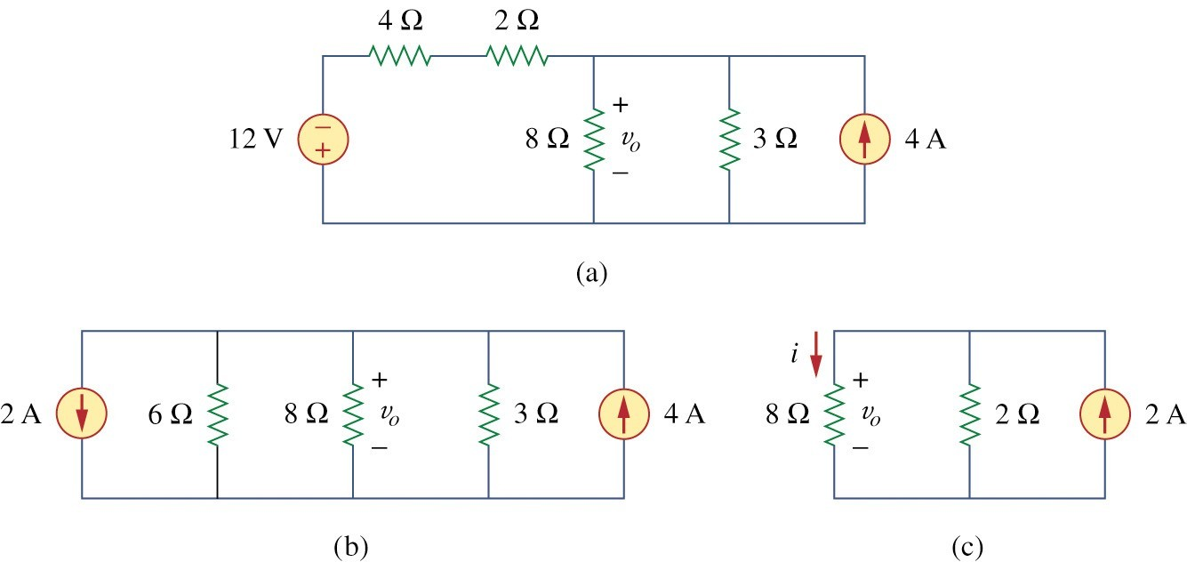
Example 6
Fig 18

Slide 27
Example 6
we use current division in Fig.18(c) to get
2
i =
(2) = 0.4A
2 + 8
and
v_{o} = 8i = 8(0.4) = 3.2V

Slide 28
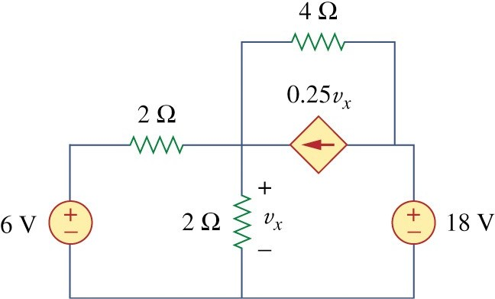
Example 7
↔ Find v_{x} in Fig.20 using source transformation

Slide 29
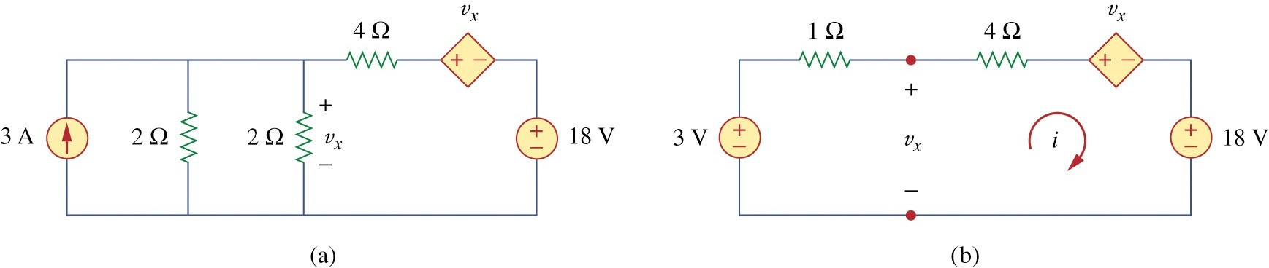
Example 7
Applying KVL around the loop in Fig 21(b) gives
− 3 + 5i + v_{x} + 18 = 0
(7.1)
Appling KVL to the loop containing only the 3V voltage source, the1Ω resistor, and v_{x} yields
− 3 + 1i + v_{x} = 0⇒ v_{x} = 3 − i
(7.2)

Slide 30
Example 7
Substituting this into Eq.(7.1), we obtain
15 + 5i + 3 = 0 ⇒ i = −4.5A
Alternatively
− v_{x} + 4i + v_{x} + 18 = 0 ⇒ i = −4.5A
thus
v_{x} = 3 − i = 7.5V

Slide 31

5 Thevenin’s Theorem
↔ Thevenin’s theorem states that a linear two- terminal circuit can be replaced by an equivalent circuit consisting of a voltage source V_{Th} in series
with a resistor R_{Th} where V_{Th} is the open circuit voltage at the terminals and R_{Th} is the input or equivalent resistance at the terminals when the independent source are turn off.

Slide 32
Property of Linear Circuits
i
i
Any two-terminal Linear Circuits
+
v
Slope=1/R_{th}
-
v
^{V}th
^{I}sc

Slide 33
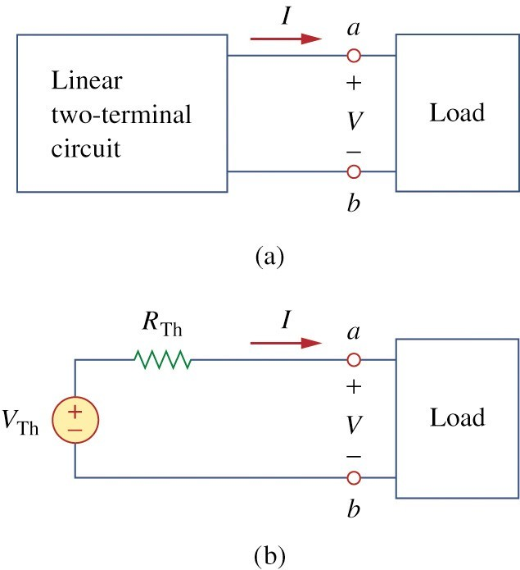
Fig. 23

Slide 34
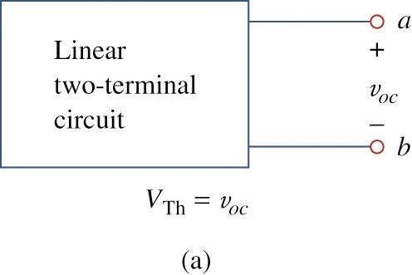
How to Find Thevenin’s Voltage
↔ Equivalent circuit: same voltage-current relation at the terminals.
↔
^{V}Th
= v_{oc} :
open circuit voltageat a − b

Slide 35
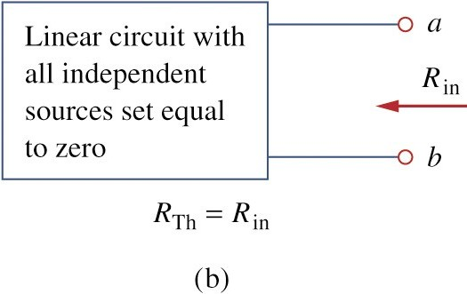
How to Find Thevenin’s Resistance
↔_{R}
= R :
Th in
input − resistanceof the dead circuit at a − b.
a − b open circuited
Turn off allindependent sources

Slide 36
CASE 1
If the network has no dependent sources:
Turn off all independent source.
R_{TH}: can be obtained via simplification of either parallel or series connection seen from a-b

Slide 37
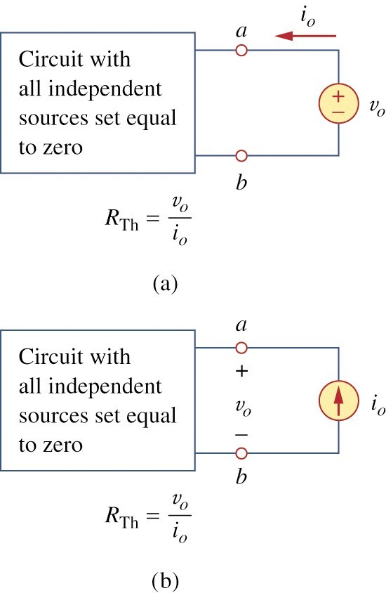
Fig. 25
CASE 2
↔ If the network has dependent
sources
Turn off all independent sources.
Apply a voltage source v_{o} at a-b
₌ v_{o}
R
Th
i
o
Alternatively, apply a current
₌ v_{o}
source i at a-b R
o
Th
i
o

Slide 38
↔ The Thevenin’s resistance may be negative, indicating that the circuit has ability providing power

Slide 39
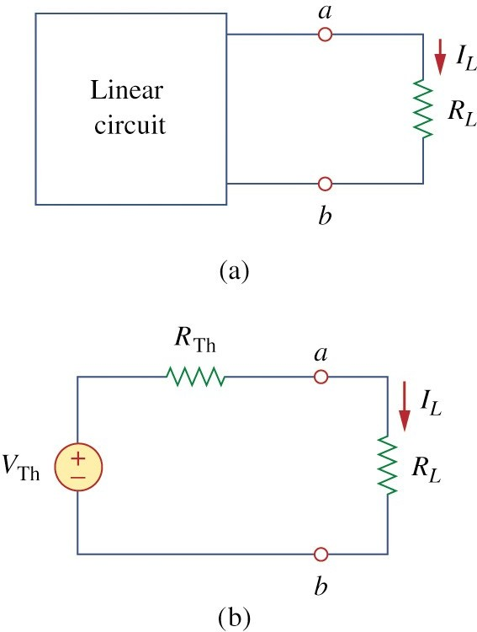
Fig. 26
Simplified circuit
^{V}Th
I =
L
R + R
Th
L
R_{L}
V_{L} = R_{L} I_{L} =
V
R + R
Th
Th
L
Voltage divider

Slide 40
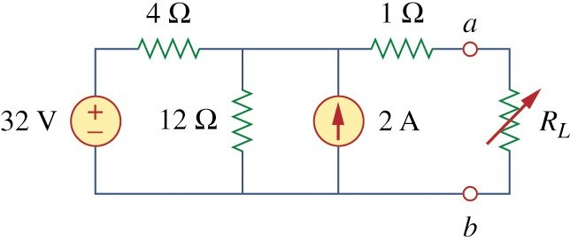
Example 8
↔ Find the Thevenin’s equivalent circuit of the circuit shown in Fig 4.27, to the left of the terminals a-b.
Then find the current through R_{L} = 6,16,and 36 Ω.

Slide 41
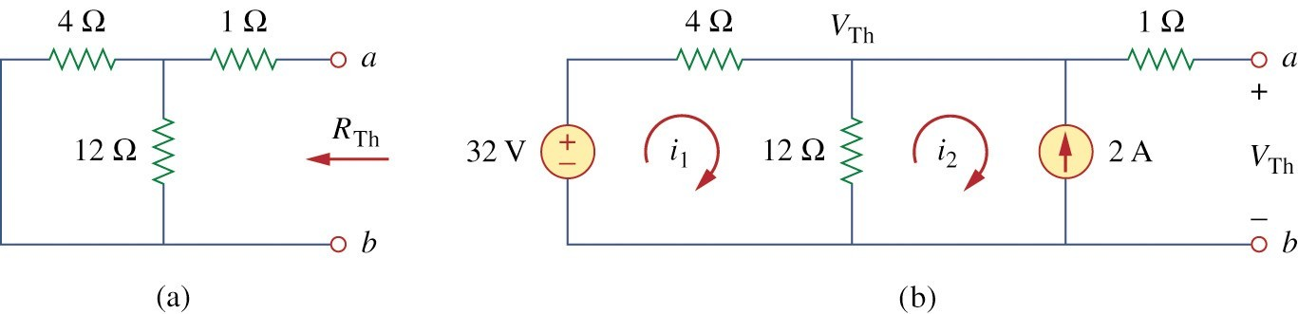
Find R_{th}
R_{Th} : 32V voltagesource →short 2A current source→open
R = 4 ||12 + 1 = ^{4 ×12} + 1 = 4Ω
Th
16

Slide 42
Find V_{th}
^{V}Th
:
(1) Mesh analysis
− 32 + 4i₁ + 12(i₁ − i₂ ) = 0 , i₂ = −2A
∴i₁ = 0.5A
^{V}Th
= 12(i₁ − i₂ ) = 12(0.5 + 2.0) = 30V
(2) Alternatively, Nodal Analysis (32 − V_{Th} ) / 4 + 2 = V_{Th} /12
∴V_{Th} = 30V

Slide 43
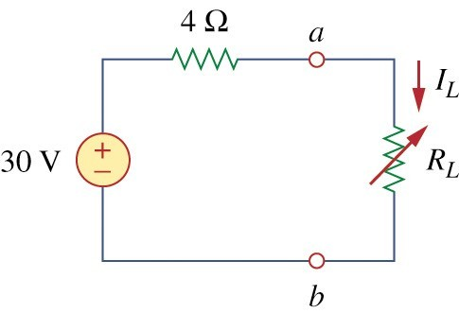
Example 4.8
(3) Alternatively, source transform
32 − V_{TH}
2 = ^{VTH}
4 12
96 − 3V_{TH} + 24 = V_{TH} ⇒ V_{TH} = 30V
Fig. 4.29
43

Slide 44
Example 8
Toget i_{L} :
^{V}Th
30
i =
=
L
R + R 4 + R
Th L L
R_{L} = 6 → I_{L} = 30 /10 = 3A
R_{L} = 16→I_{L} = 30 / 20 = 1.5A
R_{L} = 36→I_{L} = 30 / 40 = 0.75A

Slide 45
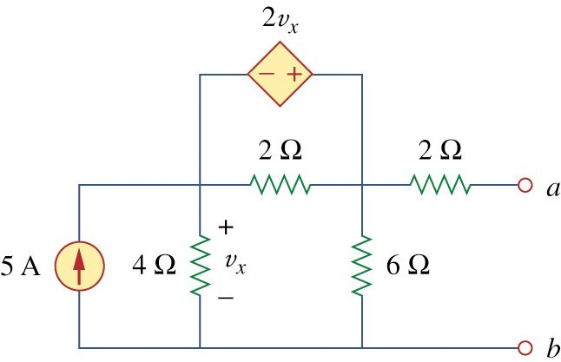
Example 9
↔ Find the Thevenin’s equivalent of the circuit in Fig.
4.31 at terminals a-b.

Slide 46
Example 9
↔ (independent + dependent source case)
To find R_{Th} : Fig(a)
independent source →0 dependent source → intact
v = 1V,
R = ^{vo} = ¹
o
Th
i i
o o

Slide 47
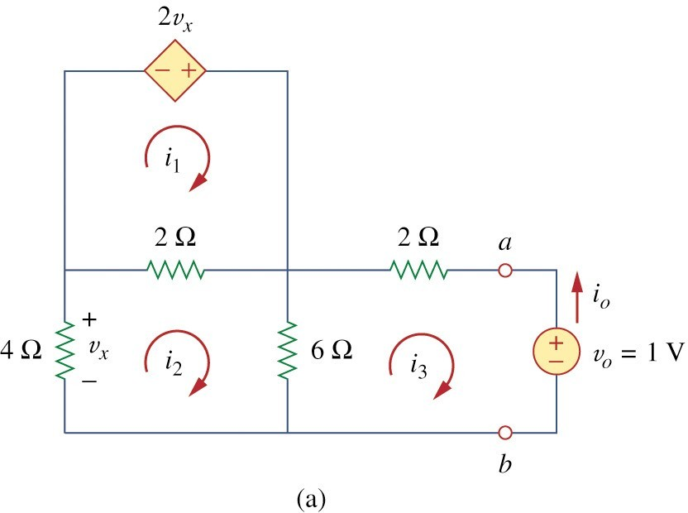
Example 9
↔ For loop 1,
− 2v_{x} + 2(i₁ − i₂ ) = 0 or v_{x} = i₁ − i₂
But − 4i = v_{x} = i₁ − i₂
∴ i₁ = −3i₂

Slide 48
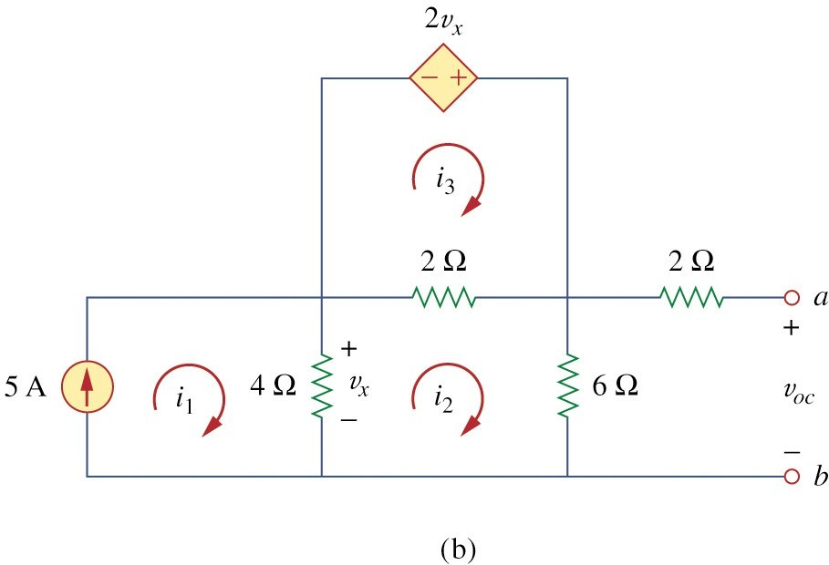
Example 9
Loop 2and 3 :
4i₂ + 2(i₂ − i₁ ) + 6(i₂ − i₃ ) = 0
6(i₃ − i₂ ) + 2i₃ + 1 = 0
Solving these equations gives
i₃ = −1/ 6A.
But i = −i = ¹ A
o 3
6
∴ R = ^{1V} = 6Ω
Th
i
o

Slide 49
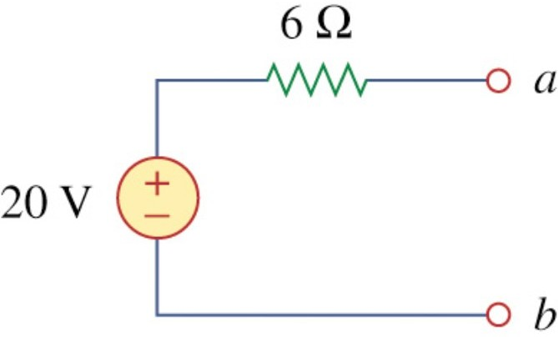
Example 9
TogetV_{Th} :Fig(b) Mesh analysis
i₁ = 5
− 2v_{x} + 2(i₃ − i₂ ) = 0 ⇒ v_{x} = i₃ − i₂ 4(i₂ − i₁ ) + 2(i₂ − i₁ ) + 6i₂ = 0 ⇒ 12i₂ But 4(i₁ − i₂ ) = v_{x}
∴i₂ = 10 / 3.
− 4i₁ − 2i₃ = 0
^{V}Th
= v_{oc} = 6i₂ = 20V

Slide 50
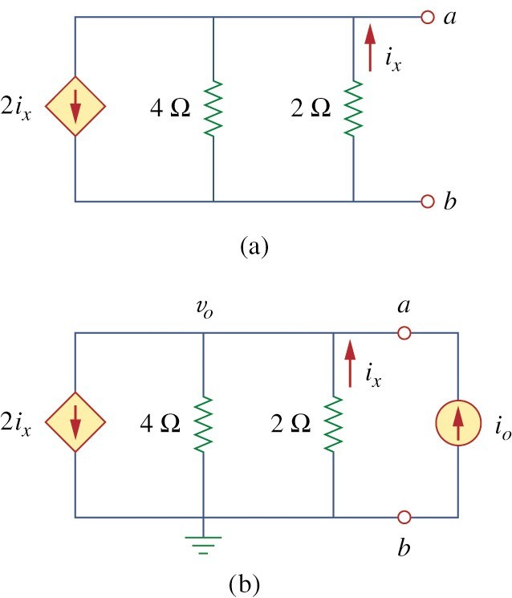
Example 10
↔ Determine the Thevenin’ equivalent circuit in Fig.35(a).
↔ Solution
(dependent sourceonly case)
s
₌ v_{o}
V = 0
R
Th
Th
i
Nodalanaysis :
i_{o} + i_{x} = 2i_{x} + v_{o} / 4
o

Slide 51
Example 10
0 − v
But
i =
o
= − ^{vo}
x
2
2
v_{o}
v_{o}
i = i
= − ^{vo}
= − ^{vo}
or v_{o} = −4i_{o}
o x
4
2 4 4
₌ v_{o}
Thus R
= −4Ω: Supplying power
Th
i
o

Slide 52
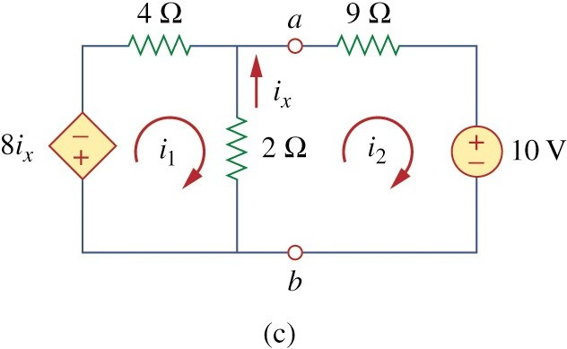
Example 10

Slide 53
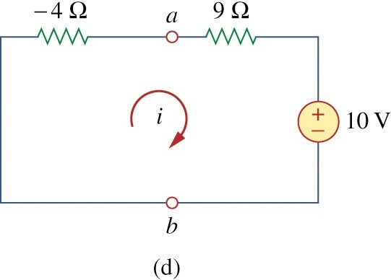
Example 10

Slide 54


6 Norton’s Theorem
↔ Norton’s theorem states that a linear two-terminal circuit can be replaced by equivalent circuit consisting of a current source I_{N} in parallel with a
resistor R_{N} where I_{N} is the short-circuit current through the terminals and R_{N} is the input or equivalent resistance at the terminals when the independent source are turn off.

Slide 55
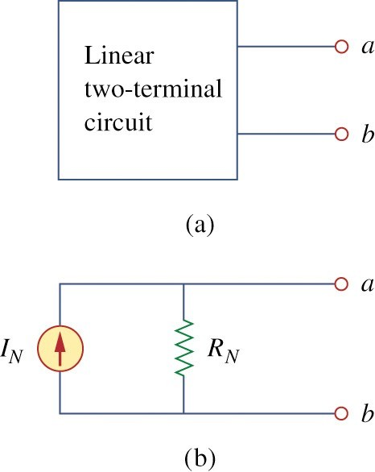
Fig. 37
i
Slope=1/R_{N}
v
^{V}th
-I_{N}

Slide 56
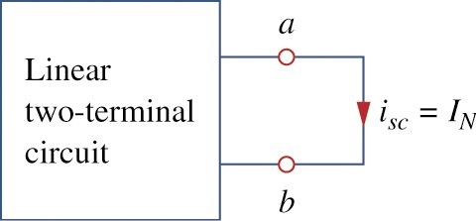
How to Find Norton Current
↔ Thevenin and Norton resistances are equal:
R_{N} = R_{Th}
↔ Short circuit current from a to b :
₌ ^{V}Th
I = i
N
sc
R
Th

Slide 57
Thevenin or Norton equivalent circuit :
↔ The open circuit voltage v_{oc} across terminals a and b
↔ The short circuit current i_{sc} at terminals a and b
↔ The equivalent or input resistance R_{in} at terminals a
and b when all independent source are turn off.
VTh =voc
IN
=isc
RTh = ^{VTh} = RN
RTh

Slide 58
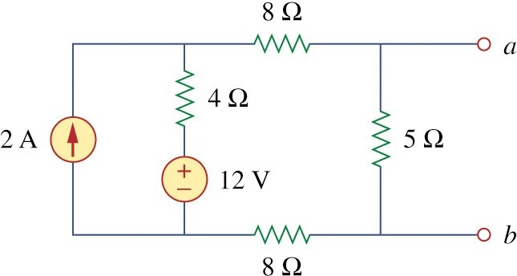
Example 11
↔ Find the Norton equivalent circuit of the circuit in Fig 39.

Slide 59
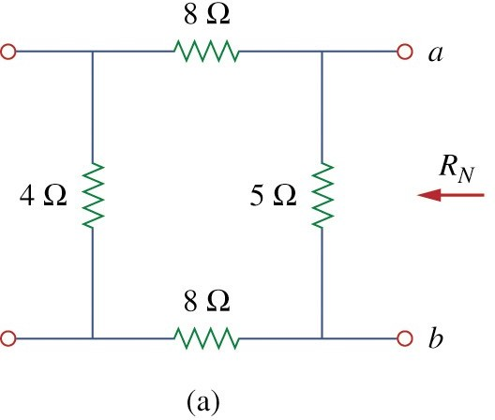
Example 11
To find R_{N}
Fig4.40(a) :
R_{N} = 5 ||(8 + 4 + 8)
= 5 || 20 = ^{20 × 5} = 4Ω
25

Slide 60
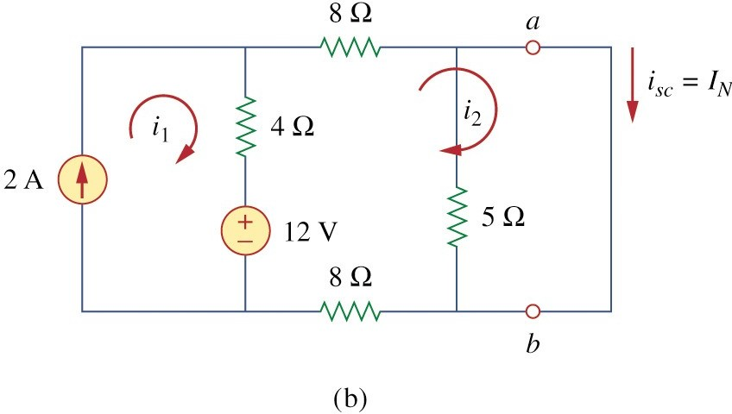
Example 11
To find i_{N}
(Fig.40(b))
short − circuit terminals a and b. Mesh : i₁ = 2A, 20i₂ − 4i₁ − i₂ = 0
i₂ = 1A = i_{sc} = IN

Slide 61
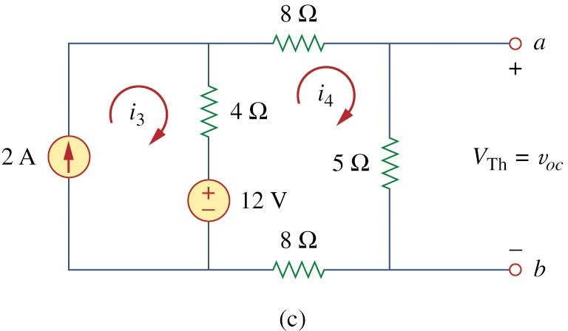
Example 11
Alternative method for IN VTh
IN =
RTh
VTh : open − circuit voltage across terminals a and b
(Fig 40(c)) :
Mesh analysis :
i3 = 2 A, 25i4 − 4i3 −12 = 0
∴i4 = 0.8A
∴voc = VTh = 5i4 = 4V

Slide 62
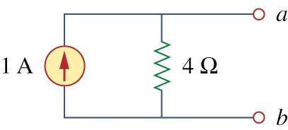
Example 11
Hence,
VTh
IN =
= 4 / 4 = 1A
RTh

Slide 63
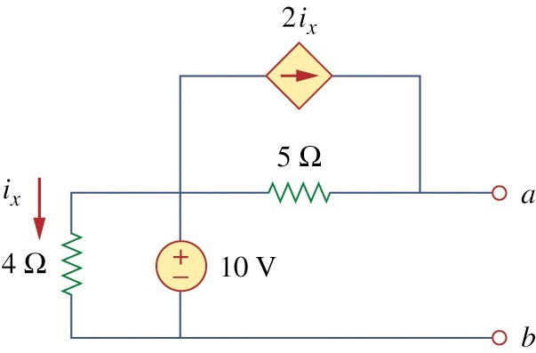
Example 12
↔ Using Norton’s theorem, find R_{N} and I_{N} of the circuit in Fig 43 at terminals a-b.

Slide 64
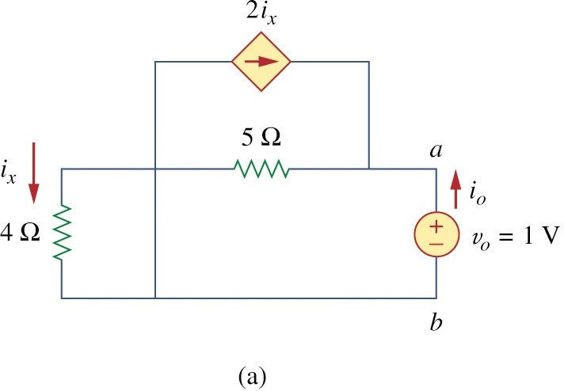
Example 12
To find R_{N}
Fig.44(a)
4Ωresistor shorted
•5Ω ||v_{o} ||2i_{x} :Parallel
Hence, i_{x} =
vo / 5 = 1/ 5 = 0.2
∴ RN = ^{vo} =
¹ = 5Ω
i_{o} 0.2

Slide 65
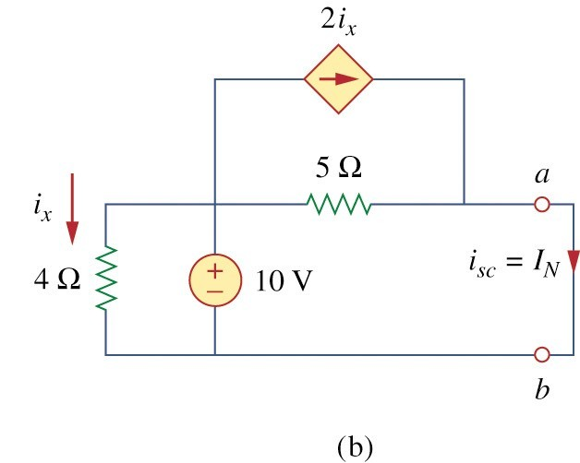
Example 12
To find I_{N}
Fig.4.44(b)
4Ω ||10v || 5Ω||2i_{x}
:Parallel
i = ¹⁰ ⁻ ⁰ = 2.5A,
x
4
10
i_{sc} = i_{x} + 2i_{x} = ₅ + 2(2.5) = 7 A
∴ I_{N} = 7A
66
5

Slide 66
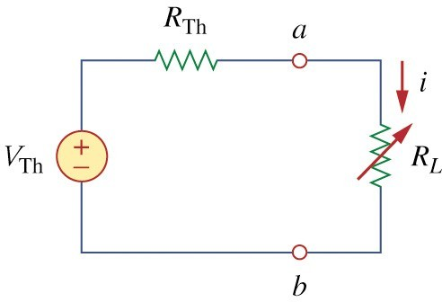
8 Maximum Power Transfer
⎞2
⎛ V
p = i² R = ⎜ ^{TH} ⎟ R
L L
⎝ R + R ⎠
TH
L
Fig 48

Slide 67


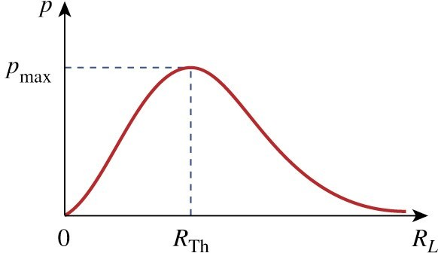
Fig. 49
↔ Maximum power is transferred to the load when the load resistance equals the Thevenin resistance as seen the load (R_{L} = R_{TH}).

Slide 68
dp ₌
⎡(R + R )² − 2R (R
L L TH
+ R )⎤
V
2
TH
TH
L
⎢⎣
⎥⎦
dR
(R + R )⁴
TH L
L
⎡(R_{TH}
+ R_{L} − 2R_{L} )⎤ ₌ ₀
= V ²
TH ⎢⎣
⎥⎦
(R + R )³
TH L
0 = (R_{TH} + R_{L} − 2R_{L} ) = (R_{TH} − R_{L} )
R_{L} = R_{TH}
_{V} 2
_{pmax =} TH
4R_{TH}

Slide 69
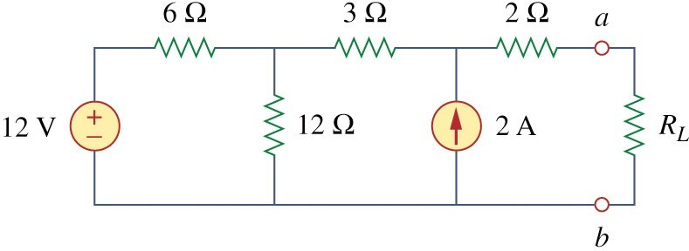
Example 13
↔ Find the value of R_{L} for maximum power transfer in the circuit of Fig. 50. Find the maximum power.

Slide 70
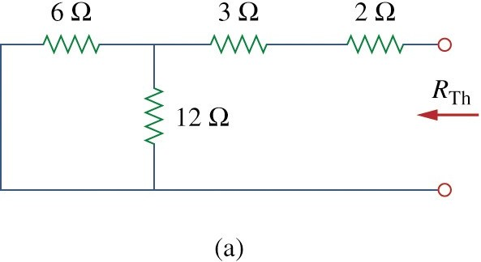
Example 13
R = 2 + 3 + 6 12 = 5 + ^{6 ×12} = 9Ω
TH
18

Slide 71
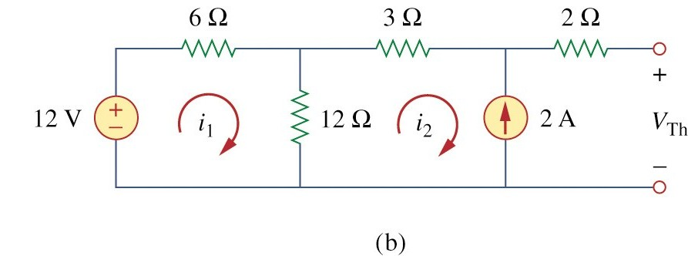
Example 13
−12 + 18i₁ −12i₂ , i₂ = −2 A
−12 + 6i_{i}1 + 3i₂ + 2(0) + V_{TH}
= 0 ⇒ V_{TH}
= 22V
R_{L} = R_{TH} = 9Ω
_{V} 2
22²
4R_{L} 4 × 9
_{pmax =} TH ₌
= 13.44W
CCiirrccuiuitt TTheorheorememss

Slide 72
Homework Problems
↔ Problems 6, 10, 21, 28, 33, 40, 47, 52, 71

